Slide 1
Opportunities Analysis – Food Services Division

Slide 2
Dataset Overview
Customer Spend (Restaurants)
Total F&B spend of current customers (restaurants) across various product categories
Share of wallet (i.e., % of that spend captured by Shaun’s company)
Non-Commercial Establishments
Data from institutions such as hospitals, schools, etc., across geographies
No current sales exist in this segment
Retail Outlets
Presence and density of retail stores in the same geographic areas
Retail is managed by a separate business division, but relevant for understanding possible cannibalization or complementary opportunities

Slide 3
Methodology
• Data Collection: Market research and internal sources
• Data Cleaning & Preparation: Ensuring consistency
• Visualization: Using dashboards for segment-wise insights
• Analysis: Identifying key patterns, trends, and opportunities

Slide 4
Data Cleaning Process
Data cleaning is essential for ensuring the accuracy and quality of the dataset. It involves identifying and rectifying issues in the data to make it suitable for analysis.
Steps Involved:
Remove Duplicates: Eliminated redundant records.
Handle Missing Values:Filled in or removed missing data.
Standardize Data Formats : Unified formats for consistency.
Filter Outliers:Detected and addressed extreme values.
Transform Data: Applied necessary data transformations.

Slide 5
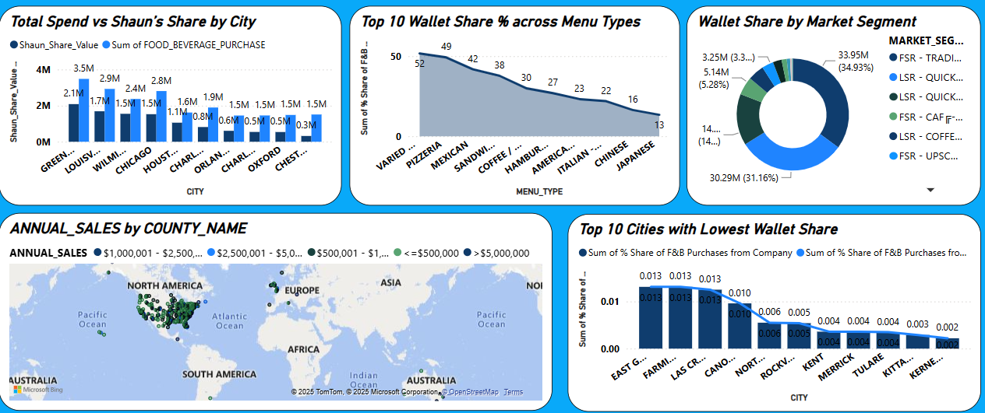
Customer Spend(Restaurants)
Key Findings:
Green Bay and Louisville have the highest F&B spend.
Pizzeria and Mexican menus lead in wallet share.
Most sales are from North America (U.S.).
Cities like East Grand Forks and Farmington have the lowest wallet share.

Slide 6
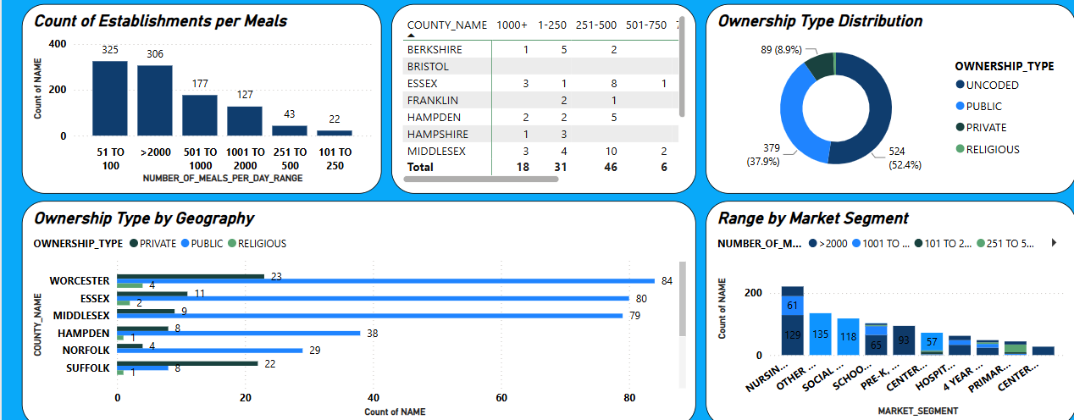
Non-Commercial F&B Opportunity Dashboard
Key Findings:
Most establishments serve 51–100 or >2000 meals/day.
Private ownership dominates (52.4%), followed by public (37.9%).
Worcester, Essex, and Middlesex have the most establishments.

Slide 7
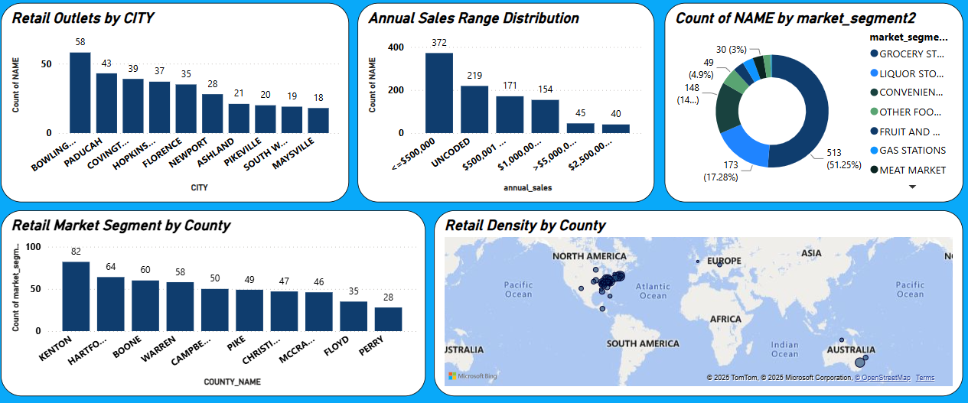
Retail Environment
Key Findings
Grocery stores dominate the retail segment (51.25%).
Majority of stores have annual sales ≤ $500,000.
Kenton, Hartford, and Boone counties lead in market segment count.
Most outlets are in Bowling Green and Paducah.

Slide 8
Team Overview
Project Contributors:
Geetanjali – Created and managed the Power BI dashboards, including visualizations and insights.
Dinesh Sharma – Cleaned and structured the raw data to ensure accuracy and consistency.
Vijay Prakash – Designed the PowerPoint presentation and organized the project flow.
Shivam Mishra – Supported across all tasks.

Slide 9


